Slide 1


Slide 2






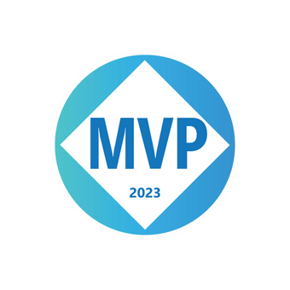
Who is Chad Green
chadgreen@chadgreen.com
TaleLearnCode
ChadGreen.com
ChadGreen & TaleLearnCode
ChadwickEGreen

Slide 3

Memphis Azure User Group
October 2023 – Azure: Unleashing the Power of Cloud Computing
November 2023 – Azure on the Cheap – Your First Azure Application
December 2023 – Automating my Dog with Azure Cognitive Services
https://memphisazure.com/

Slide 4

Louisville Azure Meetup
October 12 – Implementing Multi-Tenant AKS
November 9 – Enterprise Scale IaC using Terraform
https://meetup.com/louisville-azure-meetup

Slide 5



DevSpace
Development without Downloads: Using Online Developer Tools 2023
Multidevice Applications with Flutter
Building Great Libraries
Time Travelling Data: A Quick Overview of SQL Server Temporal Tables
Notes:
October 23 – 24
27 speakers

Slide 6
Unleashing the Power of Cloud Computing
Understanding Cloud Computing
History
Importance of Cloud Computing
Cloud Service and Deployment Models
Cloud Marketspace
Microsoft Azure
History
Azure Regions
Azure Services
Example Architectures

Slide 7
Understanding Cloud Computing
Azure: Unleashing the Power of Cloud Computing
Notes:
Cloud Computing is a technology paradigm that involves delivering various computing services, including servers, storage, databases, networking, software, and more, over the internet. These services are provided by cloud service providers who maintain and manage the underlying infrastructure. Cloud computing offers several advantages, including scalability, cost-efficiency, accessibility, and flexibility, making it a fundamental component of modern IT infrastructure.

Slide 8
History of Cloud Computing
1950s and 1960’s – Precursors to Cloud Computing
Notes:
The history of clouding computing is a relatively recent but rapidly evolving story. It is marked by a series of technological advancements, innovations, and shifts in computing paradigms. Here is a brief overview of the key milestones in the history of cloud computing:
1950s and 1960s – Precursors to Cloud Computing
The concept of utility computing, where computing resources cloud be shared like a public utility, was proposed as early as the 1950s.
In the 1960s, the ideas of time-sharing emerged, allowing multiple users to access a single computer simultaneously.

Slide 9
History of Cloud Computing
1950s and 1960’s – Precursors to Cloud Computing
1990s – Internet and Web Services
Notes:
1990s – Internet and Web Services
With the rise of the internet, the foundation for cloud computing was laid
Companies like Amazon and Salesforce stared offering web-based services that would later become integral to the cloud computing ecosystem.

Slide 10
History of Cloud Computing
1950s and 1960’s – Precursors to Cloud Computing
1990s – Internet and Web Services
2000s – Emergence of Cloud Computing
Notes:
2000s – Emergence of Cloud Computing
Amazon Web Services (AWS) launched in 2006, marking a significant milestone. AWS offered on-demand computing resources through the internet, laying the groundwork for modern cloud computing.
Google introduced Google Apps in 2006, offering web-based productivity software.
Salesforce.com, a pioneer in Software as a Service (SaaS), gained popularity with its cloud-based customer relationship management (CRM) software.

Slide 11
History of Cloud Computing
1950s and 1960’s – Precursors to Cloud Computing
1990s – Internet and Web Services
2000s – Emergence of Cloud Computing
Late 2000s – Expansion of Cloud Services
Notes:
Late 2000s – Expansion of Cloud Services
Microsoft Azure launched in 2008, providing cloud-based infrastructure and services.
The term “cloud computing” became widely recognized and used.

Slide 12
History of Cloud Computing
1950s and 1960’s – Precursors to Cloud Computing
1990s – Internet and Web Services
2000s – Emergence of Cloud Computing
Late 2000s – Expansion of Cloud Services
2010s – Maturation and Market Grown
Notes:
2010s – Maturation and Marketing Growth
The 2010s saw significant growth in cloud adoption across industries.
AWS, Microsoft Azure, and Google Cloud Platform (GCP) became major players in the cloud industry, providing a wide range of services.
Serverless computing gained traction with the introduction of AWS Lambda in 2014.
Hybrid and multi-cloud strategies became popular as organizations sought flexibility and redundancy.

Slide 13
History of Cloud Computing
1950s and 1960’s – Precursors to Cloud Computing
1990s – Internet and Web Services
2000s – Emergence of Cloud Computing
Late 2000s – Expansion of Cloud Services
2010s – Maturation and Market Grown
2020s – Ongoing Evolution
Notes:
2020s – Ongoing Evolution
Cloud computing continued to evolve with advancements in AI, machine learning, and edge computing.
The COVID-19 pandemic accelerated cloud adoption as remote work and digital transformation became imperative for many organizations.
More specialized cloud services, such as AI/ML platforms and edge computing solutions, emerged.

Slide 14
History of Cloud Computing
1950s and 1960’s – Precursors to Cloud Computing
1990s – Internet and Web Services
2000s – Emergence of Cloud Computing
Late 2000s – Expansion of Cloud Services
2010s – Maturation and Market Grown
2020s – Ongoing Evolution
Future – AI, Edge, and Quantum Computing
Notes:
Future – AI, Edge, and Quantum Computing
The future of cloud computing is expected to involve grater integration with edge computing, enabling real-time data processing closer to where it is generated.
Quantum computer is also on the horizon with potential applications for solving complex problems that are currently computationally infeasible.
Throughout its history, cloud computing has transformed the way organizations approach IT infrastructure and services. It has provided businesses with the flexibility, scalability, and cost-efficiently needed to innovate and adapt in an increasingly digital world. As technology continues to advanced, cloud computing is likely to remain tat the forefront of IT solutions.

Slide 15
History of Cloud Computing
1950s and 1960’s – Precursors to Cloud Computing
1990s – Internet and Web Services
2000s – Emergence of Cloud Computing
Late 2000s – Expansion of Cloud Services
2010s – Maturation and Market Grown
2020s – Ongoing Evolution
Future – Edge and Quantum Computing

Slide 16
Importance of Cloud Computing
Scalability and Flexibility
Notes:
Cloud computing has become a cornerstone of the modern digital landscape due to its numerous benefits and transformative potential.
Scalability and Flexibility: Cloud computing offers unparalleled scalability, allowing businesses to quickly scale up or down their resources based on demand. This elasticity enables organizations to handle varying workloads without overprovisioning resources, leading to cost savings and optimal performance.

Slide 17
Importance of Cloud Computing
Scalability and Flexibility
Cost Efficiency
Notes:
Cost Efficiency: Traditional on-premises infrastructure requires significant upfront investments in hardware, software, and maintenance. Cloud computing operates on a pay-as-you-go model, reducing capital expenditure and allowing organizations to allocate resources more efficiently.

Slide 18
Importance of Cloud Computing
Scalability and Flexibility
Cost Efficiency
Global Accessibility
Notes:
Global Accessibility: Cloud services are accessible from anywhere with an internet connection. This is particularly crucial in today's interconnected world where remote work, collaboration, and access to data and applications are essential.

Slide 19
Importance of Cloud Computing
Scalability and Flexibility
Cost Efficiency
Global Accessibility
Innovation Acceleration
Notes:
Innovation Acceleration: Cloud providers offer a wide array of services, including artificial intelligence, machine learning, analytics, and more. These services enable businesses to leverage cutting-edge technologies without the need for deep expertise or large upfront investments.

Slide 20
Importance of Cloud Computing
Scalability and Flexibility
Cost Efficiency
Global Accessibility
Innovation Acceleration
Faster Time-to-Market
Notes:
Faster Time-to-Market: Cloud services enable rapid deployment of applications and services. This agility is essential for businesses seeking to launch new products or services quickly, responding to market demands faster than traditional methods allow.

Slide 21
Importance of Cloud Computing
Scalability and Flexibility
Cost Efficiency
Global Accessibility
Innovation Acceleration
Faster Time-to-Market
Disaster Recovery and Business Continuity
Notes:
Disaster Recovery and Business Continuity: Cloud computing provides robust disaster recovery capabilities. Data is redundantly stored across multiple data centers, reducing the risk of data loss due to hardware failures or disasters.

Slide 22
Importance of Cloud Computing
Scalability and Flexibility
Cost Efficiency
Global Accessibility
Innovation Acceleration
Faster Time-to-Market
Disaster Recovery and Business Continuity
Security and Compliance
Notes:
Security and Compliance: Leading cloud providers implement stringent security measures, often exceeding what many organizations can achieve on their own. Compliance certifications and built-in security features alleviate concerns about data protection and privacy.

Slide 23
Importance of Cloud Computing
Scalability and Flexibility
Cost Efficiency
Global Accessibility
Innovation Acceleration
Faster Time-to-Market
Disaster Recovery and Business Continuity
Security and Compliance
Environmental Impact
Notes:
Environmental Impact: Cloud computing allows resource sharing, optimizing server utilization and reducing energy consumption compared to traditional data centers. This aligns with sustainability goals and reduces the carbon footprint.

Slide 24
Importance of Cloud Computing
Scalability and Flexibility
Cost Efficiency
Global Accessibility
Innovation Acceleration
Faster Time-to-Market
Disaster Recovery and Business Continuity
Security and Compliance
Environmental Impact
Collaboration and Mobility
Notes:
Collaboration and Mobility: Cloud services enable seamless collaboration among teams regardless of geographical locations. Real-time document sharing, version control, and remote access enhance productivity and collaboration.

Slide 25
Importance of Cloud Computing
Scalability and Flexibility
Cost Efficiency
Global Accessibility
Innovation Acceleration
Faster Time-to-Market
Disaster Recovery and Business Continuity
Security and Compliance
Environmental Impact
Collaboration and Mobility
Focus on Core Competencies
Notes:
Focus on Core Competencies: By offloading infrastructure management to cloud providers, businesses can focus their resources and expertise on core activities that directly contribute to their growth and competitiveness.

Slide 26
Importance of Cloud Computing
Scalability and Flexibility
Cost Efficiency
Global Accessibility
Innovation Acceleration
Faster Time-to-Market
Disaster Recovery and Business Continuity
Security and Compliance
Environmental Impact
Collaboration and Mobility
Focus on Core Competencies
Support for Moden Workloads
Notes:
Support for Modern Workloads: Cloud computing is well-suited for modern applications and architectures, such as microservices, containers, and serverless computing, enabling organizations to embrace the latest technological trends.

Slide 27
Importance of Cloud Computing
Scalability and Flexibility
Cost Efficiency
Global Accessibility
Innovation Acceleration
Faster Time-to-Market
Disaster Recovery and Business Continuity
Security and Compliance
Environmental Impact
Collaboration and Mobility
Focus on Core Competencies
Support for Moden Workloads
Notes:
In essence, cloud computing revolutionizes the way businesses operate, offering the agility, cost-efficiency, and innovation required to stay competitive in today's dynamic digital environment. It empowers organizations to transform their IT infrastructure and operations, ultimately driving growth and success.

Slide 28
Cloud Service Models
Infrastructure as a Service (IaaS)
Notes:
There are typically two primary service models in cloud computing:
Infrastructure as a Service (IaaS): In the IaaS model, cloud providers offer virtualized computing resources over the internet. This includes virtual machines, storage, and networking. Users can rent these resources on a pay-as-you-go basis. IaaS providers a high degree of flexibility, as users can configure and manage the virtualized infrastructure as needed. It is suitable for organizations that want to maintain control over their operating systems and software but do not want to manage physical hardware

Slide 29
Cloud Service Models
Infrastructure as a Service (IaaS)
Platform as a Service (PaaS)
Notes:
Platform as a Service (PaaS): PaaS takes the cloud computing concept a step further by providing a platform that includes not only infrastructure but also development tools and services. It offers an environment for developers to build, deploy, and manage applications without worrying about the underlying infrastructure. PaaS is well-suited for application development, as it simplifies the development and deployment processes, making it faster and more efficient.

Slide 30
Cloud Service Models
Infrastructure as a Service (IaaS)
Platform as a Service (PaaS)
Serverless
Notes:
Serverless refers to a cloud server model where the cloud provider manages the underlying infrastructure for you, automatically allocating and deallocating resources based on your actual usage. In this model, you are not responsible for provisioning or managing servers; instead, you focus on using and configuring the service.
Serverless cloud computing simplifies resource management and cost optimization. These services automatically adjust to your application’s needs, ensuring that you have the necessary resources when your workload requires them and scaling down during periods of inactivity to minimize costs.
Overall, serverless cloud computing services provide a more flexible and cost-effective approach to using cloud databases without the need for manual resource management.

Slide 31
Cloud Service Models
Infrastructure as a Service (IaaS)
Platform as a Service (PaaS)
Serverless
Function as a Service (FaaS)
Notes:
Function as a Service (FaaS), is a cloud computing model in which cloud providers automatically manage the infrastructure needed to execute code, allowing developers to focus solely on writing application logic in the form of functions. With FaaS, developers write individual functions or microservices and these functions are executed in response to specific events or triggers, such as HTTP requests, database changes, or file uploads.
Key characteristics of serverless computing include:
No Server Management: In a serverless model, developers are relieved of the responsibility for provisioning, configuring, and managing servers. The cloud provider dynamically manages the infrastructure, automatically scaling resources as needed.
Event-Driven: Serverless functions are triggered by events or requests, and they execute in response to these events. For example, a function might be triggered by an HTTP request, a new record in a database, or the arrival of a message in a queue.
Automatically Scaling: Serverless platforms automatically scale the execution environment to match the incoming workload. If many requests or events occur simultaneously, the cloud provider allocates additional resources to handle them., Conversely, when the workload decreases, resource are deallocated to save costs.
Billing Based on Usage: Serverless computing follows a pay-as-you-go pricing model. Users are charged based on the actual execution time and resources consumed by their functions. There is no charge when functions are idle.
Stateless: Serverless functions are designed to be stateless, meaning they do not maintain persistent data between executions. Data can be stored in databases, object stores, or other external services.
Microservices Architecture: Serverless encourages the decomposition of applications into small, single-purpose functions or microservices. Each function performs a specific task, making it easier to manage and scale individual components.
Rapid Development: Serverless computing promotes rapid development and deployment. Developers can focus on writing code without the need to manage infrastructure, which can lead to faster time-to—market for applications.
Popular serverless platforms include AWS Lambda, Azure Functions, Google Cloud Functions, and others. These platforms provide a wide range of event sources and integrations, making it possible to build highly scalable and responsible applications without the overhead of managing serves. Serverless computing is particularly well-suited for applications with variable workloads and event-driven architectures, such as web and mobile backends, IoT applications, and data processing pipelines.

Slide 32
Cloud Service Models
Infrastructure as a Service (IaaS)
Platform as a Service (PaaS)
Serverless
Function as a Service (FaaS)

Slide 33
Cloud Service Models
Infrastructure as a Service (IaaS)
Platform as a Service (PaaS)
Serverless
Software as a Service (SaaS)
Function as a Service (FaaS)
Notes:
Software as a Service (SaaS): SaaS is a cloud service model where software applications are hosted and delivered over the internet on a subscription basis. Users can access these applications through a web browsers, eliminating the need for local installation and maintenance. SaaS applications cover a wide range of functionalities, from office productivity tools like email and document editing to specializing software like customer relationship management (CRM) and enterprise resource planning (ERP) systems. SaaS is convenient for businesses as it reduces the burden of software management and updates.

Slide 34
Cloud Deployment Models
Public Cloud
Notes:
Along with the service models, there are two primary deployment models:
Public Cloud: Public cloud services are offered by cloud providers to multiple organizations over the internet., These service are hosted on the provider’s infrastructure, and users access resources from shared data centers. Public clouds are cost-effective and scalable, making them suitable for a wide range of applications.

Slide 35
Cloud Deployment Models
Public Cloud
Private Cloud
Notes:
Private Cloud: Private clouds are cloud infrastructures that are provisioned and used by a single organization. They can be hosted on-premises or by a third-party provider. Private clouds offer grater control, security, and customization but may have higher infrastructure and maintenance costs.

Slide 36
Cloud Deployment Models
Public Cloud
Private Cloud
Hybrid Cloud
Notes:
In addition to these primary deployment models, there are hybrid cloud models that combine elements of both public and private clouds. Hybrid clouds allow data and applications to be shared between them, offering flexibility, scalability, and control.
Some examples of where the hybrid cloud deployment model is commonly used:
Data Backup and Disaster Recovery (DR): Organizations often use a hybrid cloud to create backup and disaster recovery solutions. Critical data is regularly backed up to a private cloud or on-premises infrastructure, while less critical data is stored in the public cloud. In the event of a disaster, data can be quickly restored from the private cloud or on-premises infrastructure to ensure business continuity.
Regulatory Compliance: Industries such as finance, healthcare, and government often have strict regulatory requirements regarding data handling and storage. Hybrid clouds allow organizations to keep sensitive or regulated data on-premises or in a private cloud, while using the public cloud for less sensitive workloads.
Development and Testing Environments: Hybrid clouds are popular for creating development and testing environments. Developers can use the public cloud to quickly provision resources for testing and development, and then deploy the final product on the private cloud or on-premises infrastructure.
Bursting Workloads: Organizations with variable workloads may use the public cloud to handle spikes in demand. For example, a retail company may run its e-commerce site on a private cloud but use the public cloud to handle increased traffic during holiday seasons.
IoT and Edge Computing: In IoT, data is often collected at the edge, closed to where it is generated. Hybrid cloud deployments and involving processing this data locally at the edge (in a private cloud or on edge devices) and then sending relevant data to the public cloud for further analysis and long-term storage.
Content Delivery: Hybrid clouds are used in content delivery networks (CDNs) to deliver content efficiently. Frequently accessed content may be cached in the public cloud, while less frequently accessed content resides in a private or on-premises storage.
Global Scalability: Multinational companies can use a hybrid cloud approach to deploy applications and services globally. Critical data and applications can be hosted in private cloudes close to specific geographic locations, while non-critical services can be run in the public cloud.
Legacy System Integration: Organizations with legacy systems may opt for a hybrid cloud to gradually migrate to the cloud. Legacy applications can remain on-premises or in a private cloud, while new services are deployed in the public cloud.

Slide 37


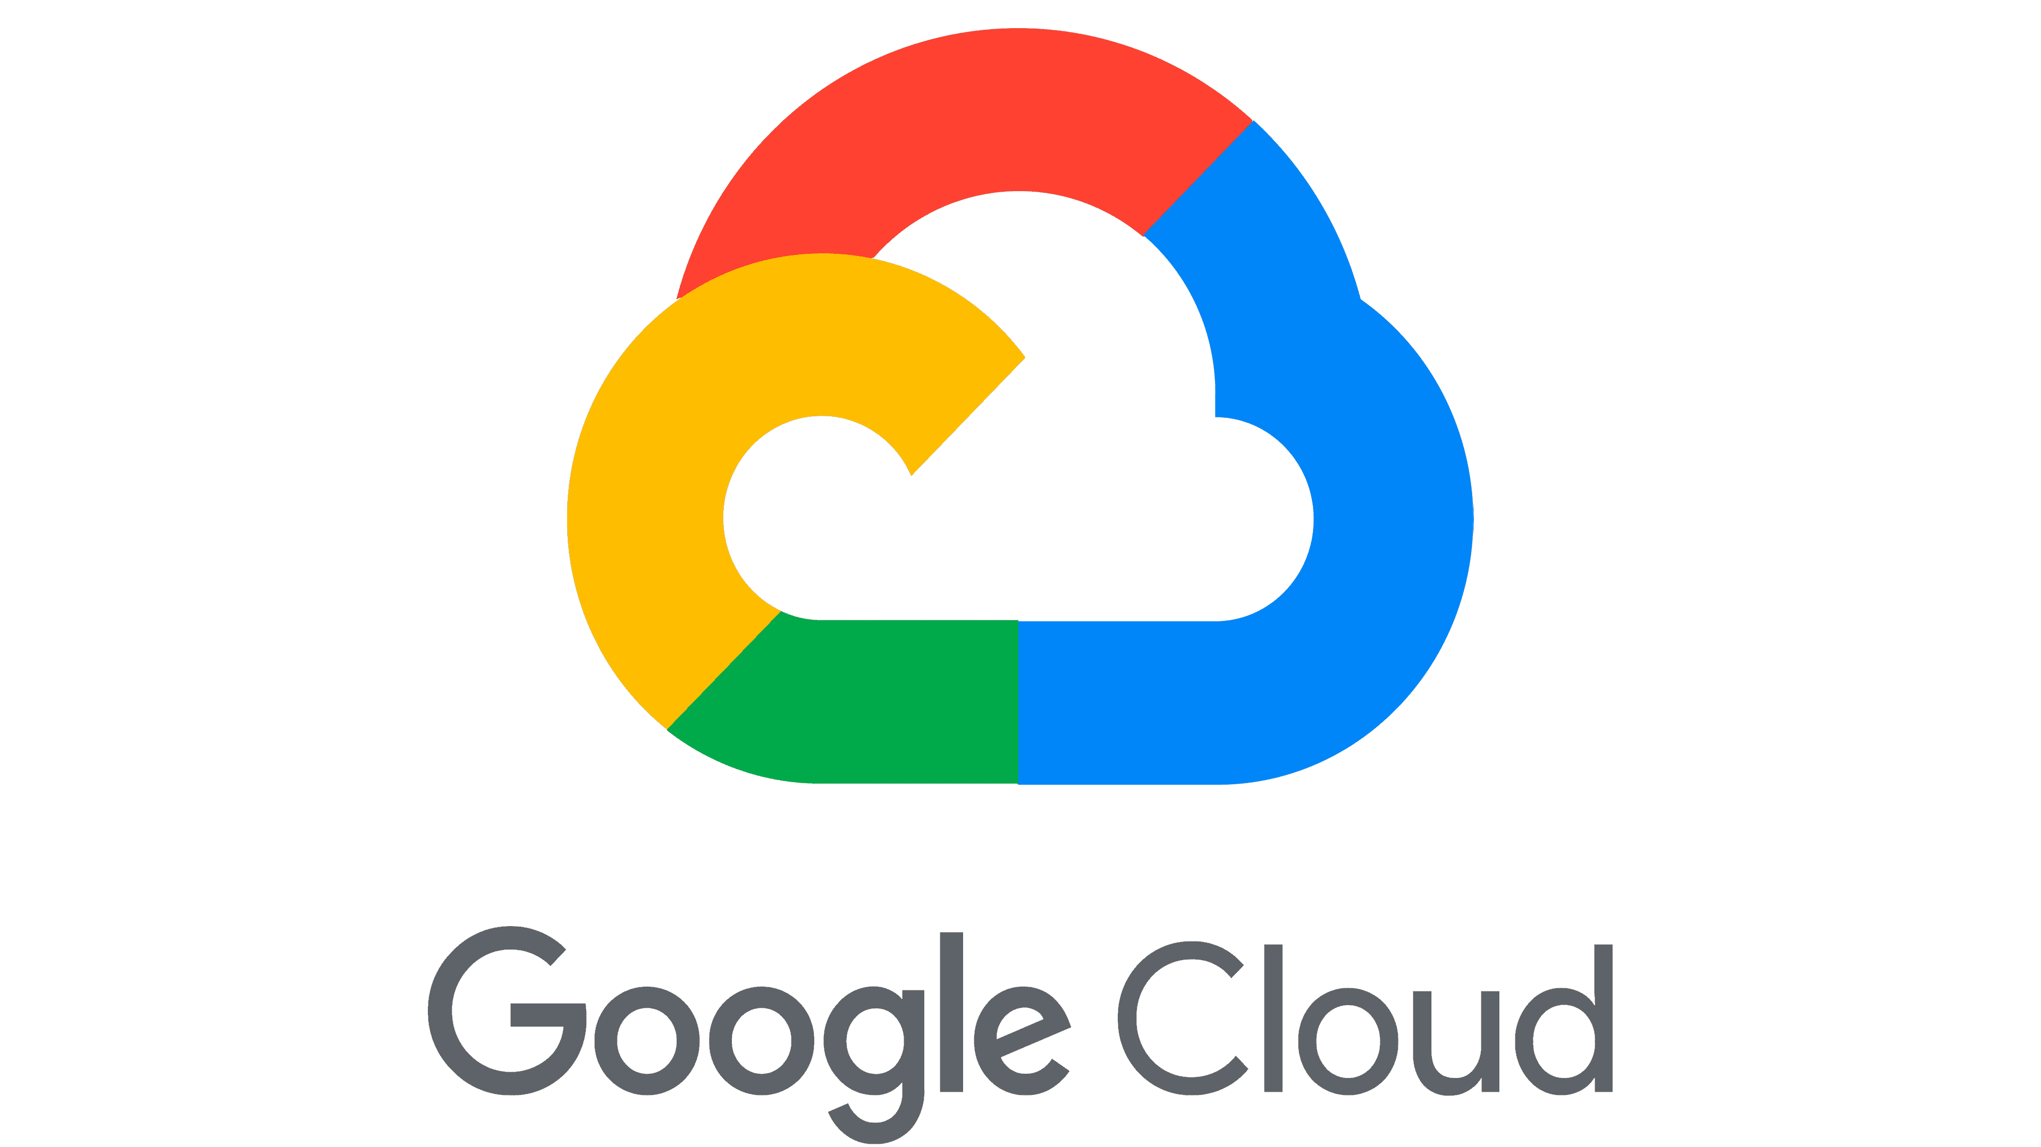
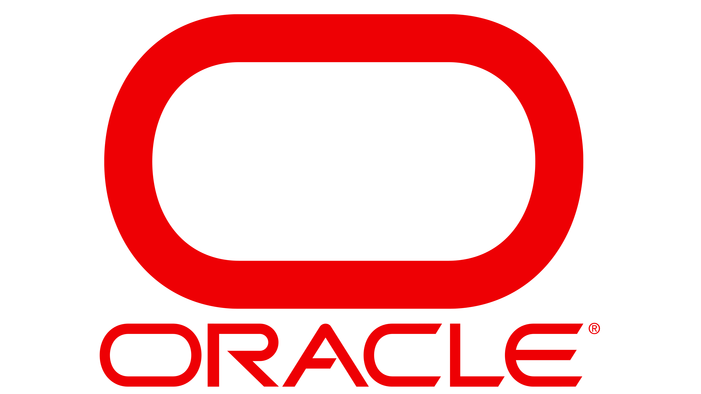
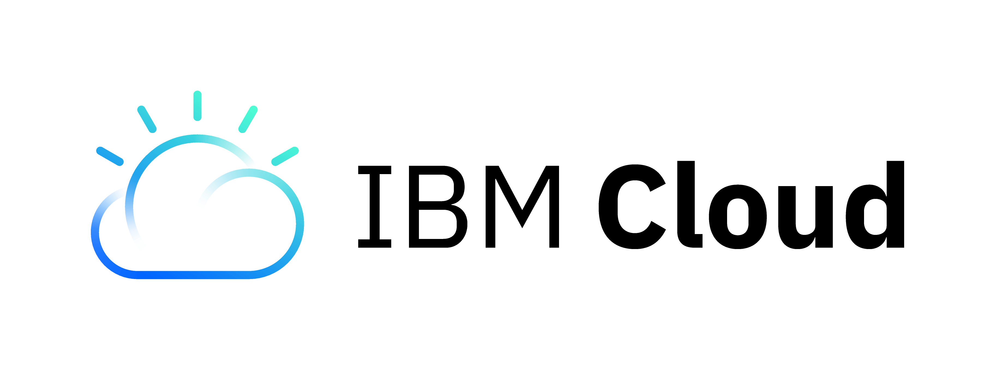
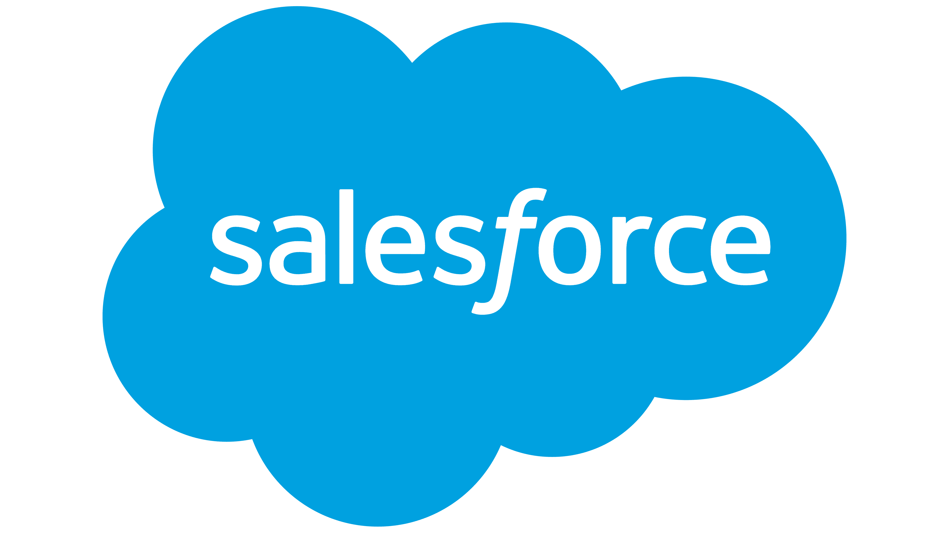

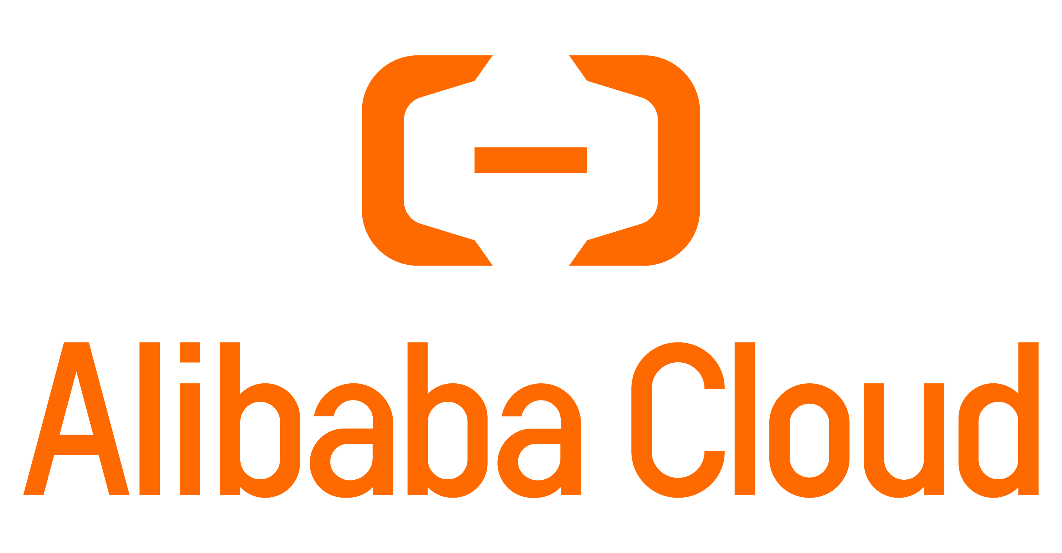
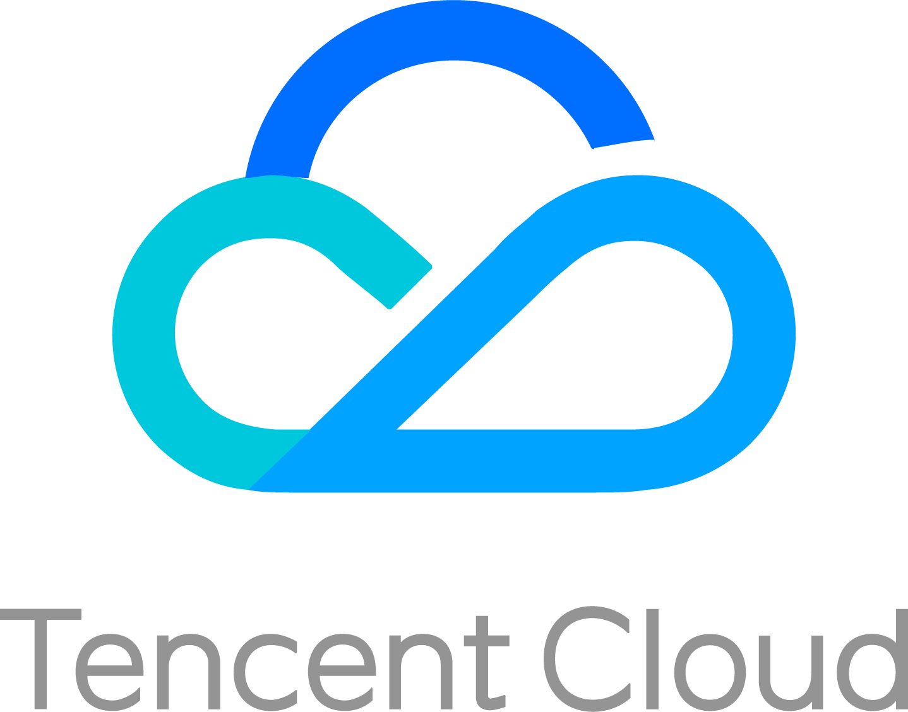
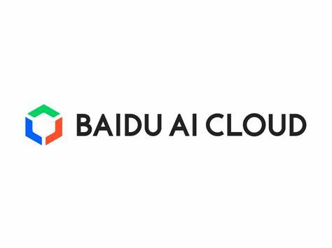
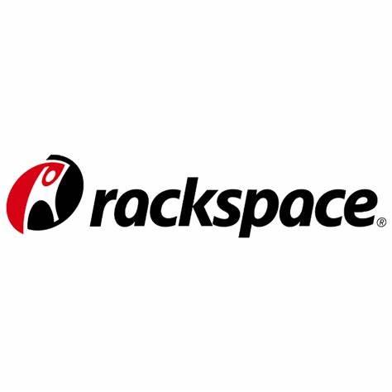
Cloud Marketspace
Notes:
Amazon Web Services (AWS): AWS is the larges and most widely adopted cloud provider. It offers a vast array of cloud services, including computing power, storage, databases, machine learning, analytics, and more.
Microsoft Azure: Azure is Microsoft’s cloud computing platform. It provides a comprehensive suite of services, including virtual machines, databases, AI and machine learning, IoT, and developers tools. Azure is known for it its integration with Microsoft’s other products like Windows and Active Directory.
Google Cloud Platform (CGP): GCP is Google’s cloud offering, known for its strengths in data analytics, machine learning, and big data services. It provides a range of cloud services, including compute, storage, databases, and container orchestration through Kubernetes.
IBM Cloud: IBM Cloud offers a variety of cloud services, including infrastructure as a service (IaaS), platform as a service (PaaS), and software as a service (SaaS). IBM’s acquisition of Red Hat bolstered its position in hybrid cloud and container technologies.
Oracle Cloud: Oracle Cloud provides cloud infrastructure and platform services. It is particularly focused on database services, enterprise software, and cloud applications.
Alibaba Cloud: Alibaba Cloud is a leading cloud provider in Asia and is expanding its global presence. It offers a wide range of cloud services, including computing, databases, big data, and AI.
Salesforce: Salesforce is well-known for its customer relationship management (CRM) software. It also offers a cloud platform, Salesforce Platform, that allows developers to build and deploy applications in the cloud.
Tencent Cloud: Tencent Cloud is a major cloud provider in China and is expanding its global footprint. It offers cloud services such as computing, databases, and AI.
Baidu Cloud: Baidu Cloud is another significant cloud provider in China, offering a variety of cloud services, including AI and machine learning.
DigitalOcean: DigitalOcean is known for its simplicity and developer-friendly cloud services. It specializes in providing cloud infrastructure for developers and small to medium-sized businesses.
Rackspace Technology: Rackspace provides managed cloud services, helping businesses optimize and manage their cloud environments, including services on AWS, Azure, and GCP.

Slide 38
Microsoft Azure
Azure: Unleashing the Power of Cloud Computing

Slide 39
Microsoft Azure History
Project Red Dog (2006-2008)
Notes:
Project Red Dog (2006-2008): The development of Azure began under the codename “Project Red Dog” in 2006. It was an effort to build a cloud operating system that would allow Microsoft to enter the rapidly growing cloud services market.

Slide 40
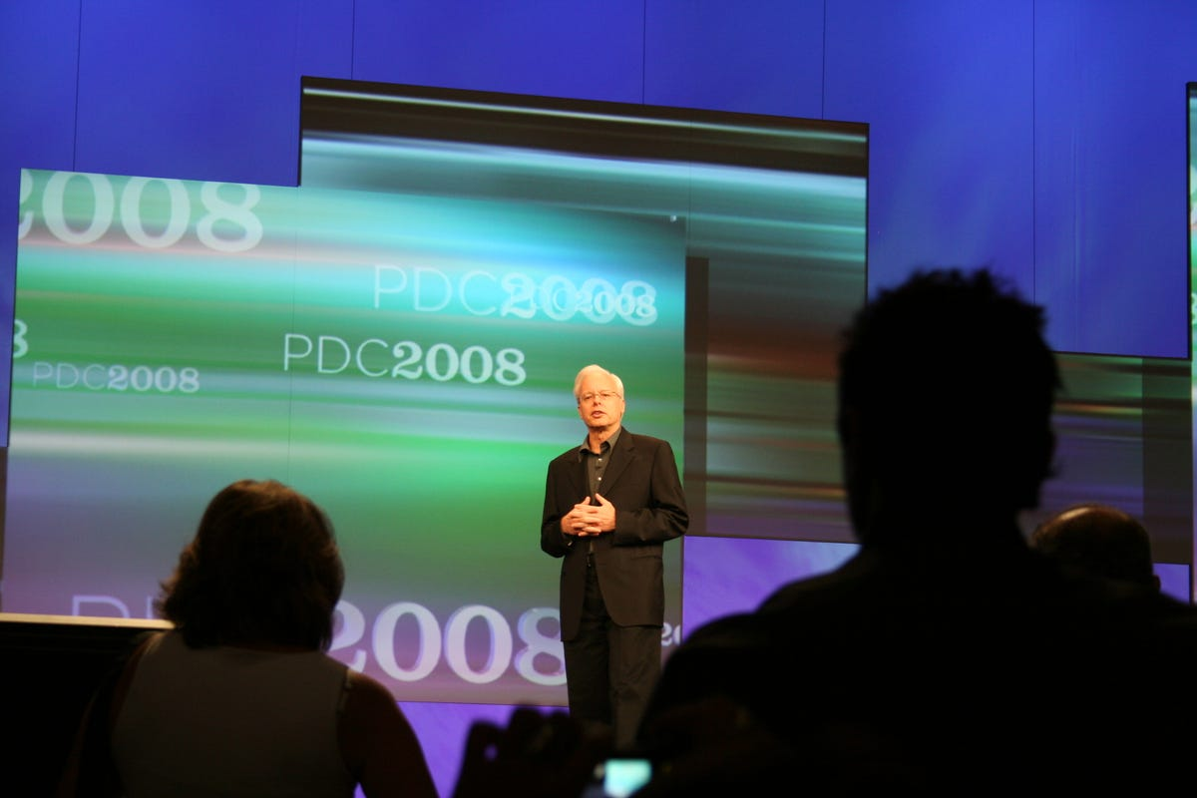
Microsoft Azure History
Project Red Dog (2006-2008)
Azure Announced (2008)
Notes:
Azure Announced (2008): Microsoft officially announced Azure at the Professional Developers Conference (PDC) in October 2008. At this stage, it was known as “Windows Azure.”

Slide 41
Microsoft Azure History
Project Red Dog (2006-2008)
Azure Announced (2008)
Commercial Release (2010)
Notes:
Commercial Release (2010): In February 2010, Azure was commercially released to the public. This marked the beginning of Azure’s availability for businesses and devleopers to use for building, deploying, and managing applications and services in the cloud.

Slide 42
Microsoft Azure History
Project Red Dog (2006-2008)
Azure Announced (2008)
Commercial Release (2010)
Rebranding as Microsoft Azure (2014)
Notes:
Rebranding as Microsoft Azure (2014): In March 2014, Microsoft announced that it would change the name from “Windows Azure” to “Microsoft Azure” to better reflect the platforms broad support for various technologies, including Linux and open-source software.

Slide 43
Microsoft Azure History
Project Red Dog (2006-2008)
Azure Announced (2008)
Commercial Release (2010)
Rebranding as Microsoft Azure (2014)
Expansion of Services
Notes:
Expansion of Services: Over the years, Microsoft continued to expand Azure’s offerings, adding a wide range of services such as virtual machines, databases, AI and machine learning tools, IoT services, and more.

Slide 44
Microsoft Azure History
Project Red Dog (2006-2008)
Azure Announced (2008)
Commercial Release (2010)
Rebranding as Microsoft Azure (2014)
Expansion of Services
Hybrid Cloud Solutions (2015-2016)
Notes:
Hybrid Cloud Solutions (2015-2016): Microsoft introduces solutions like Azure Stack in 2015 and Azure Stack Hub in 2016, allowing organizations to extend Azure services to their on-premises data centers, enabling hybrid cloud deployments.

Slide 45
Microsoft Azure History
Project Red Dog (2006-2008)
Azure Announced (2008)
Commercial Release (2010)
Rebranding as Microsoft Azure (2014)
Expansion of Services
Hybrid Cloud Solutions (2015-2016)
Global Data Center Expansion
Notes:
Global Data Center Expansion: Microsoft has invested heavily in building data centers around the world to expand Azure’s global reach. This has led to the availability of Azure services in multiple regions globally.

Slide 46
Microsoft Azure History
Project Red Dog (2006-2008)
Azure Announced (2008)
Commercial Release (2010)
Rebranding as Microsoft Azure (2014)
Expansion of Services
Hybrid Cloud Solutions (2015-2016)
Global Data Center Expansion
AI and Machine Learning Advancements
Notes:
AI and Machine Learning Advancements: Azure has seen significant advancements in AI and machine learning capabilities, with services like Azure Machine Learning and Cognitive Services.

Slide 47
Microsoft Azure History
Project Red Dog (2006-2008)
Azure Announced (2008)
Commercial Release (2010)
Rebranding as Microsoft Azure (2014)
Expansion of Services
Hybrid Cloud Solutions (2015-2016)
Global Data Center Expansion
AI and Machine Learning Advancements
Edge Computing
Notes:
Edge Computing: Microsoft has expanded its Azure offerings to include edge computing solutions, allowing organization to process data closer to where it is generated, reducing latency.

Slide 48
Microsoft Azure History
Project Red Dog (2006-2008)
Azure Announced (2008)
Commercial Release (2010)
Rebranding as Microsoft Azure (2014)
Expansion of Services
Hybrid Cloud Solutions (2015-2016)
Global Data Center Expansion
AI and Machine Learning Advancements
Edge Computing
Sustainability Commitments
Notes:
Sustainability Commitments: Microsoft has committed to becoming carbon negative by 2030, and Azure is a key part of this effort, with initiatives to increase energy efficiency and use renewable energy.

Slide 49
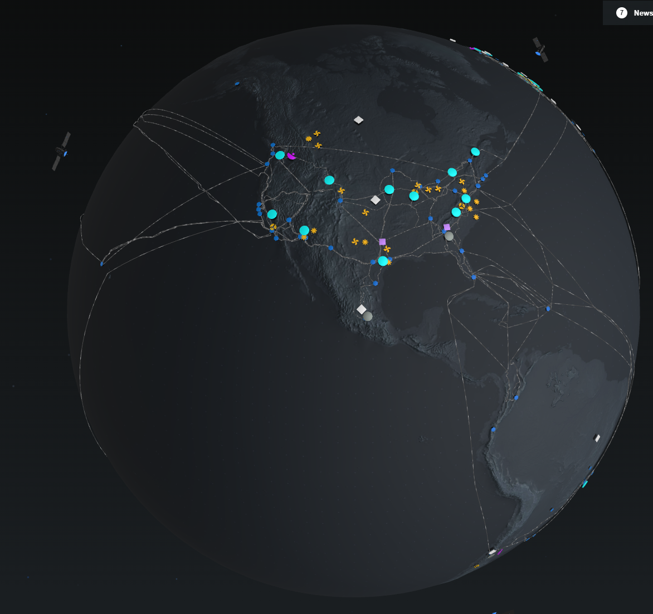
Azure Regions
48 Active Regions
17 Regions In-Development
Notes:
https://datacenters.microsoft.com/globe/explore
48 active regions; 17 regions coming soon (65 total)

Slide 50
Azure Regions
United States
United States Government
Central US (Iowa)
East US (Virginia)
East US 2 (Virginia)
East US 3 (Georgia) *
North Central US (Illinois)
South Central US (Texas)
West Central US (Wyoming)
West US (California)
West US 2 (Washington)
West US 3 (Arizona)
US DoD Central (Iowa)
US DoD East (Virginia)
US Government Arizona (Arizona)
US Government Texas (Texas)
US Government Virginia (Virginia)
US Secret East (Undisclosed)
US Secret West (Undisclosed)
US Secret West Central (Undisclosed) *

Slide 51
Azure Regions
Americas
Oceania / Africa
Brazil South (São Paulo)
Canada Central
Canada East
Chile Central *
Mexico Central *
Australia Central (Canberra)
Australia East (New South Wales)
Australia Southeast (Victoria)
New Zealand North (Auckland) *
South Africa North (Johannesburg)

Slide 52
Azure Regions (Europe)
Austria East (Vienna) *
Belgium Central (Brussels) *
Denmark East (Copenhagen) *
North Europe (Ireland)
West Europe (Netherlands)
Finland Central (Helsinki) *
France Central (Paris)
Germany West Central (Frankfurt)
Greece Central (Athens) *
Italy North (Milan)
Norway East (Oslo)
Poland Central
Spain Central (Madrid) *
Sweden Central (Gävle)
Switzerland North (Zürich)
UK South (London)
UK West (Cardiff)

Slide 53
Azure Regions (Asia)
Israel Central (Israel) *
Qatar Central (Doha)
UAE North (Dubai)
Southeast Asia (Singapore)
China East (Shanghai)
China East 2 (Shanghai)
China North (Beijing)
China North 2 (Beijing)
China North 3 (Hebei)
Central India (Pune)
India South Central (Hyderabad) *
South India (Chennai)
Indonesia Central (Jakarta) *
Japan East (Tokyo)
Japan West (Osaka)
Korea Central (Seoul)
Malaysia West (Kuala Lumpur) *
Saudi Arabia Central (Saudi Arabia) *
Taiwan North (Taipei) *

Slide 54

Azure Services
Compute
Virtual Machines
VM Scale Sets
Azure Red Hat OpenShift
Azure VMware Solution
Dedicated Host
Dedicated Host
CycleCloud
Virtual Desktop
Kubernetes Service
Container Apps
Container Instances
Cloud Services
Container Registry
App Service
Azure Functions
Azure Batch
Cloud Services
Cloud Services
Notes:
Analytics
Access cloud compute capacity and scale on demand—and only pay for the resources you use
Azure Synapse Analytics – Limitless analytics with unmatched time to insight
Azure Databricks – Design AI with Apache Spark-based analytics
Microsoft Purview – Govern, protect, and manage your data estate
Azure Data Factory – Hybrid data integration at enterprise scale, made easy
HDInsight – Provision cloud Hadoop, Spark, R Server, HBase, and Storm clusters
Azure Stream Analytics – Real-time analytics on fast-moving streaming data
Azure Machine Learning – Build, train, and deploy models from the cloud to the edge
Azure Analysis Services – Enterprise-grade analytics engine as a service
Azure Data Lake Storage – Scalable, secure data lake for high-performance analytics
Azure Data Explorer – Fast and highly scalable data exploration service

Slide 55

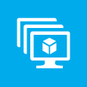

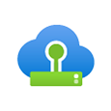



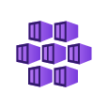


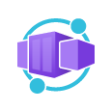






Azure Services
Compute
Virtual Machines
VM Scale Sets
Azure Red Hat OpenShift
Azure VMware Solution
Dedicated Host
CycleCloud
Virtual Desktop
Kubernetes Service
Container Instances
Container Registry
Container Apps
App Service
Azure Functions
Azure Batch
Cloud Services
Service Fabric
Azure Quantum
Notes:
Compute
Access cloud compute capacity and scale on demand—and only pay for the resources you use
Virtual Machines – Provision Windows and Linux virtual machines in seconds
https://azure.microsoft.com/en-us/products/virtual-machines/
VM Scale Sets – Manage and scale up to thousands of Linux and Windows virtual machines
https://azure.microsoft.com/en-us/products/virtual-machine-scale-sets/
Azure Red Hat OpenShift – Fully managed OpenShift service, jointly operated with Red Hat
https://azure.microsoft.com/services/openshift
Azure VMware Solution – Run your VMware workloads natively on Azure
https://azure.microsoft.com/en-us/products/azure-vmware/
Dedicated Host – A dedicated physical server to host your Azure VMs for Windows and Linux
https://azure.microsoft.com/en-us/products/virtual-machines/dedicated-host/
CycleCloud – Create, manage, operate, and optimize HPC and big compute clusters of any scale
https://azuremarketplace.microsoft.com/en-us/marketplace/apps/azurecyclecloud.azure-cyclecloud?tab=Overview
Virtual Desktop – Deliver a virtual desktop experience to any device at cloud scale
https://azure.microsoft.com/en-us/products/virtual-desktop/
Kubernetes Service – Simplify the deployment, management, and operations of Kubernetes
https://azure.microsoft.com/en-us/products/kubernetes-service/
Container Instances – Easily run containers on Azure without managing servers
https://azure.microsoft.com/services/container-instances
Container Registry – Store and manage container images across all types of Azure deployments
https://azure.microsoft.com/services/container-registry
Container Apps – Build and deploy modern apps and microservices using serverless containers
https://azure.microsoft.com/en-us/products/container-apps/
App Service - Quickly create powerful cloud apps for web and mobile
https://azure.microsoft.com/en-us/products/app-service/
Azure Functions – Process events with serverless code
https://azure.microsoft.com/services/functions
Azure Batch – Cloud-scale job scheduling and compute management
https://azure.microsoft.com/services/batch
Cloud Services – Create highly-available, infinitely-scalable cloud applications and APIs
https://azure.microsoft.com/services/cloud-services
Service Fabric – Develop microservices and orchestrate containers on Windows or Linux
https://azure.microsoft.com/en-us/products/service-fabric/
Azure Quantum – Experience quantum impact today on Azure
https://azure.microsoft.com/services/quantum

Slide 56



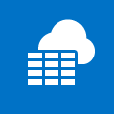










Azure Services
Networking
Application Gateway
Azure Bastion
Azure DNS
Azure Firewall
Azure Front Door
Azure Orbital
ExpressRoute
Internet Analyzer
Load Balancer
Network Watcher
Private Link
Route Server
Traffic Manager
Virtual Network
Virtual WAN
VPN Gateway
Notes:
Networking
Connect cloud and on-premises infrastructure and services to provide your customers and users the best possible experience
Application Gateway – Build secure, scalable, and highly available web front ends in Azure
https://azure.microsoft.com/services/application-gateway
Azure Bastion – Private and fully managed RDP and SSH access to your virtual machines
https://azure.microsoft.com/services/azure-bastion
Azure DNS – Host your DNS domain in Azure
https://azure.microsoft.com/en-us/products/dns/
Azure Firewall – Native firewalling capabilities with built-in high availability, unrestricted cloud scalability, and zero maintenance
https://azure.microsoft.com/en-us/products/azure-firewall/
Azure Front Door – Scalable, security-enhanced delivery point for global, microservice-based web applications
https://azure.microsoft.com/services/frontdoor
Azure Orbital – Satellite ground station and scheduling service connected to Azure for fast downlinking of data
https://azure.microsoft.com/en-us/products/orbital/
ExpressRoute – Dedicated private network fiber connections to Azure
https://azure.microsoft.com/services/expressroute
Internet Analyzer – Test how networking infrastructure changes will impact your customers performance
https://azure.microsoft.com/services/internet-analyzer
Load Balancer – Deliver high availability and network performances to your applications
https://azure.microsoft.com/services/load-balancer
Network Watcher – Network performance monitoring and diagnostics solution
https://azure.microsoft.com/services/network-watcher
Private Link – Private access to services hosted on the Azure platform, keeping your data on the Microsoft network
https://azure.microsoft.com/services/private-link
Route Server – Enable network appliances to exchange routes dynamically with virtual networks in Azure
https://azure.microsoft.com/services/route-server
Traffic Manager – Route incoming traffic for high performance and availability
https://azure.microsoft.com/services/traffic-manager
Virtual Network – Provision private networks, optionally connect to on-premises datacenters
https://azure.microsoft.com/services/virtual-network
Virtual WAN – Optimize and automate branch to branch connectivity through Azure
https://azure.microsoft.com/services/virtual-wan
VNet Manager – Centrally manage virtual networks in Azure from a single pane of glass
https://azure.microsoft.com/services/virtual-network-manager
VPN Gateway – Establish secure, cross-premises connectivity
https://azure.microsoft.com/services/vpn-gateway

Slide 57

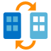







Azure Services
Identity and Security
Azure Active Directory
Azure AD External Identities
Azure AD Domain Services
Defender for Cloud
Microsoft Sentinel
Dedicated HSM
Azure Key Vault
Information Protection
DDoS Protection
Notes:
Identity and Security
Manage user identities and access to protect against advanced threats across devices, data, apps, and infrastructure
Protect your enterprise from advanced threats across hybrid cloud workloads
Azure Active Directory – Synchronize on-premises directories and enable single sign-on
https://azure.microsoft.com/services/active-directory
Azure AD External Identities – Consumer identity and access management in the cloud
https://azure.microsoft.com/services/active-directory-b2c
Azure AD Domain Services – Join Azure virtual machines to a domain without domain controllers
https://azure.microsoft.com/services/active-directory-ds
Defender for Cloud – Extend threat protection to any infrastructure
https://azure.microsoft.com/services/security-center
Microsoft Sentinel – Standing watch, by your side. Intelligent security analytics for your entire enterprise
https://azure.microsoft.com/services/azure-sentinel
Dedicated HSM – Manage hardware security modules that you use in the cloud
https://azure.microsoft.com/services/azure-dedicated-hsm
Azure Key Vault – Safeguard and maintain control of keys and other secrets
https://azure.microsoft.com/services/key-vault
Information Protection – Beter protect your sensitive information – anytime, anywhere
https://azure.microsoft.com/services/information-protection
DDoS Protection – Protect your applications from Distributed Denial of Service (DDoS) attacks
https://azure.microsoft.com/services/ddos-protection

Slide 58





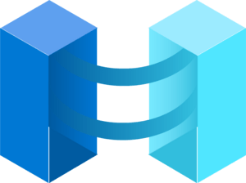




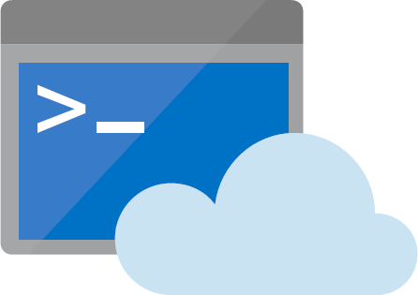
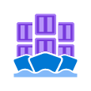
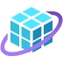
Azure Services
Management & Governance
Automation
Azure Advisor
Azure Arc
Azure Automanage
Azure Backup
Azure Blueprints
Azure Lighthouse
Azure Monitor
Azure Policy
Azure Portal
Cloud Shell
Cost Management
Kubernetes Fleet Manager
Managed Apps
Notes:
Management & Governance
Simplify, automate, and optimize the management and compliance of your cloud resources
Automation – Simplify cloud management with process automation
https://azure.microsoft.com/services/automation
Azure Advisor – Your personalized Azure best practices recommendation engine
https://azure.microsoft.com/services/advisor
Azure Arc – Bring Azure services and management to any infrastructure
https://azure.microsoft.com/services/azure-arc
Azure Automanage – Simplify management of Windows Server virtual machines
https://azure.microsoft.com/services/azure-automanage
Azure Backup – Simplify data protection and protect against ransomware
https://azure.microsoft.com/services/backup
Azure Blueprints – Enabling quick, repeatable creation of governed environments
https://azure.microsoft.com/services/blueprints
Azure Lighthouse – Empowering service providers to manage customers at scale and with precision
https://azure.microsoft.com/services/azure-lighthouse
Azure Monitor – Full observability into your applications, infrastructure, and network
https://azure.microsoft.com/services/monitor
Azure Policy – Implement corporate governance and standards at scale for Azure resources
https://azure.microsoft.com/services/azure-policy
Azure Portal – Build, manage, and monitor all Azure products in a single, unified console
https://azure.microsoft.com/features/azure-portal
Cloud Shell – Streamline Azure administration with a browser-based shell
https://azure.microsoft.com/en-us/get-started/azure-portal/cloud-shell/
Cost Management – Optimize what you spend on the cloud, while maximizing cloud potential
https://azure.microsoft.com/en-us/products/cost-management/
Kubernetes Fleet Manager – Seamlessly manage Kubernetes clusters at scale
https://learn.microsoft.com/en-us/azure/kubernetes-fleet/overview
Managed Apps – Simplify management of cloud offerings
https://azure.microsoft.com/en-us/products/managed-applications/

Slide 59




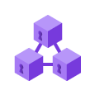






Azure Services
Storage
Avere vFXT
Azure Elastic SAN
Azure NetApp Files
Azure Storage
Confidential Ledger
Data Lake Storage
Data Share
HPC Cache
Managed Disks
Managed Lustre
StorSimple
Notes:
Storage
Get secure, massively scalable cloud storage for your data, apps, and workloads
Azure vFXT – Run high-performance, file-based workloads in the cloud
https://azure.microsoft.com/services/storage%5Cavere-vfxt
Azure Elastic SAN – Cloud-native Storage Area Network (SAN) service built on Azure
https://azure.microsoft.com/en-us/products/storage/elastic-san
Azure NetApp Files – Enterprise-grade Azure file shares, powered by NetApp
https://azure.microsoft.com/services/netapp
Azure Storage – Durable, highly available, and massively scalable cloud storage
https://azure.microsoft.com/services/storage
Confidential Ledger – Easily use a REST API managed service to store your unstructured metadata in blockchain structure
https://learn.microsoft.com/en-us/azure/confidential-ledger/overview
Data Lake Storage – Massively scalable, secure data lake functionality built on Azure Blob Storage
https://azure.microsoft.com/services/storage/data-lake-storage
Data Share – A simple and safe service for sharing big data with external organizations
https://azure.microsoft.com/services/data-share
HPC Cache – File caching for high-performance computer (HPC)
https://azure.microsoft.com/services/hpc-cache
Managed Disks – Persistent, secured disk storage for Azure virtual machines
https://azure.microsoft.com/services/managed-disks
Managed Lustre – Fully managed, cloud based parallel file system that enables customers to run their performance computing (HPC) workloads in the cloud
https://azure.microsoft.com/en-us/products/managed-lustre/
StorSimple – Lower costs with an enterprise hybrid cloud storage solution
https://azure.microsoft.com/services/storsimple

Slide 60
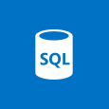
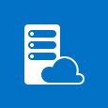








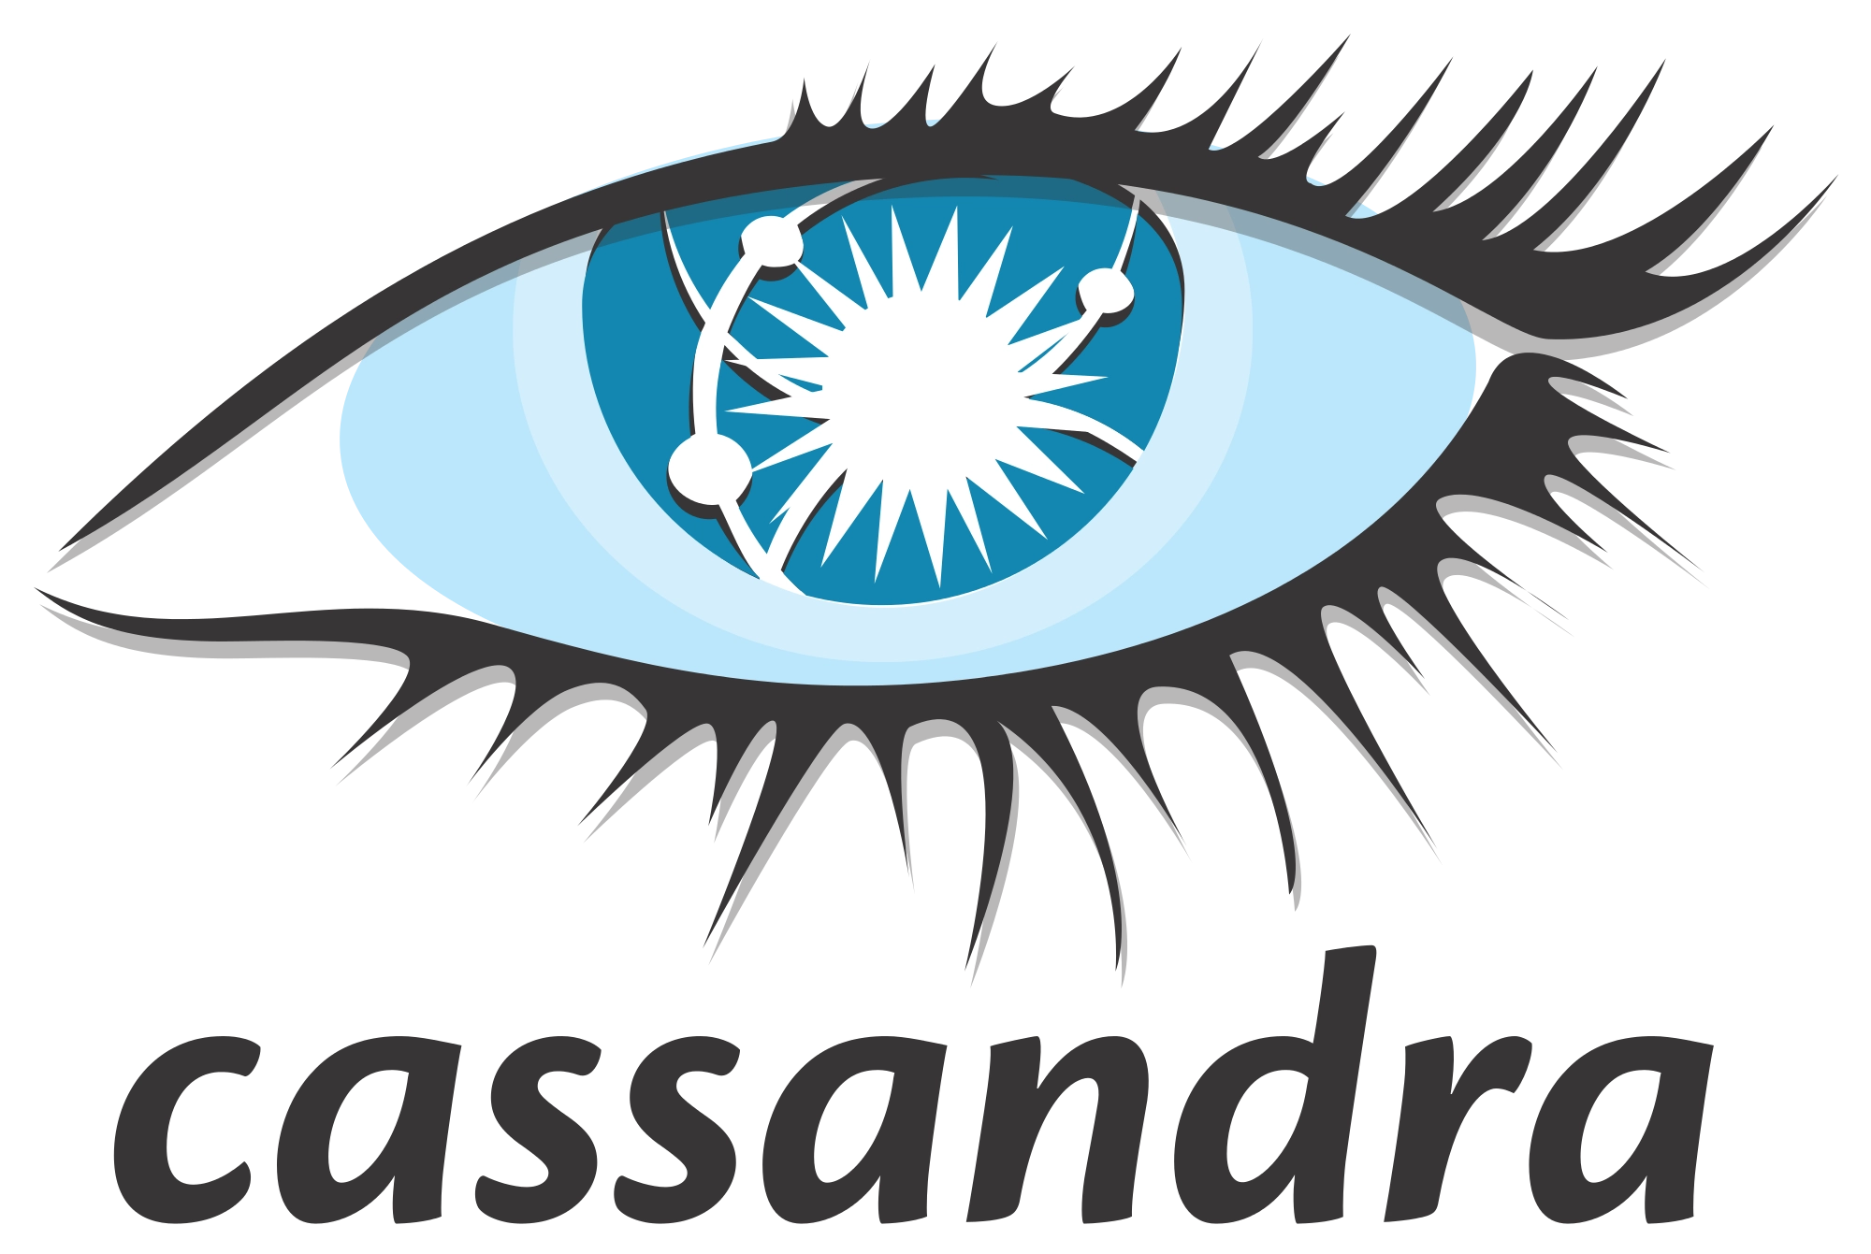
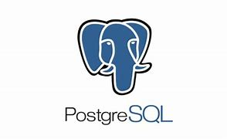
Azure Services
Databases
SQL Database
SQL Managed Instance
SQL Server Stretch DB
Cosmos DB
Database for MariaDB
Database for MySQL
Database for PostgreSQL
Apache Cassandra Managed Instance
Azure Cache for Redis
NoSQL
NoSQL
MongoDB
Apache Cassandra
Apache Gremlin
Table
PostgreSQL
Notes:
Databases
Support rapid growth and innovate faster with secure, enterprise-grade, and fully managed database services
SQL Database – Managed, intelligent SQL in the cloud
https://azure.microsoft.com/en-us/products/azure-sql/database/
SQL Managed Instance – Modernize SQL Server applications with a managed, always-up-to-date SQL instance in the cloud
https://azure.microsoft.com/en-us/products/azure-sql/managed-instance/
SQL Server Stretch DB – Dynamically stretch on-premises SQL Server databases to Azure
https://azure.microsoft.com/en-us/products/sql-server-stretch-database/
Cosmos DB – Globally distributed, multi-model database for any scale
https://azure.microsoft.com/en-us/products/cosmos-db/
Database for MariaDB – Managed MariaDB database service for app developers
https://azure.microsoft.com/en-us/products/mariadb/
Database for MySQL – Managed MySQL database service for app developers
https://azure.microsoft.com/en-us/products/mysql/
Database for PostreSQL – Managed PostgreSQL database service for app developers
https://azure.microsoft.com/en-us/products/postgresql/
Apache Cassandra Managed Instance – Managed Apache Cassandra instance in the cloud
https://azure.microsoft.com/en-us/products/managed-instance-apache-cassandra/
Azure Cache for Redis – Power applications with high-throughput, low-latency data access
https://azure.microsoft.com/en-us/products/cache/

Slide 61












Azure Services
Analytics
Analysis Services
Azure Purview
Data Catalog
Data Explorer
Data Factory
Data Lake Analytics
Databricks
HDInsight
Microsoft Fabric
Operator Insights
Power BI Embedded
Stream Analytics
Synapse Analytics
Notes:
Analytics
Gather, store, process, analyze, and visualize data of any variety, volume, or velocity
Analysis Services – Enterprise-grade analytics engine as a service
https://azure.microsoft.com/en-us/products/analysis-services/
Azure Purview – Maximize business value with unified data governance
https://azure.microsoft.com/en-us/products/purview/
Data Catalog – Get more value from your enterprise data assets
https://azure.microsoft.com/en-us/products/data-catalog/
Data Explorer – Fast and highly scalable data exploration service
https://azure.microsoft.com/en-us/products/data-explorer/
Data Factory – Hybrid data integration at enterprise scale
https://azure.microsoft.com/en-us/products/data-factory/
Data Lake Analytics – Distributed analytics service that makes big data easy
https://azure.microsoft.com/en-us/products/data-lake-analytics/
Databricks – Fast, easy, and collaborative Apache Spark-based analytics platform
https://azure.microsoft.com/en-us/products/databricks/
HDInsight – Provision cloud Hadoop, Spark, R Server, HBase, and Storm clusters
https://azure.microsoft.com/en-us/products/hdinsight/
Microsoft Fabric – Reshape how everyone accesses, manages, and acts on data and insights
https://www.microsoft.com/en-us/microsoft-fabric
Operator Insights – Unified visibility into data from disaggregated networks for end-to-end analytical and business insights
https://azure.microsoft.com/en-us/products/operator-insights/
Power BI Embedded – Embed fully interactive, stunning data visualizations in your applications
https://azure.microsoft.com/en-us/products/power-bi-embedded/
Stream Analytics – Real-time data stream processing from millions of IoT devices
https://azure.microsoft.com/en-us/products/stream-analytics/
Synapse Analytics – Limitless analytics service with unmatched time to insight
https://azure.microsoft.com/en-us/products/synapse-analytics/

Slide 62











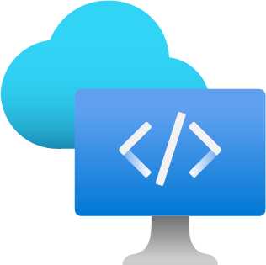
Azure Services
Development
Azure DevOps
Visual Studio App Center
Managed Grafana
Azure Chaos Studio
App Configuration
Deployment Environments
DevTest Labs
Load Testing
Lab Services
SingalR Service
Azure Spring Apps
Microsoft Dev Box
Notes:
Development
Build, manage, and continuously deliver cloud applications—using any platform or language
Azure DevOps – Services for teams to share code, track work, and ship software
https://azure.microsoft.com/services/devops
Visual Studio App Center – Continuously build, test, release, and monitor your apps
https://azure.microsoft.com/en-us/products/app-center/
Managed Grafana – Deploy Grafana dashboards as a fully managed Azure service
https://azure.microsoft.com/en-us/products/managed-grafana/
Azure Chaos Studio – Improve application resilience by introducing faults and simulating outages
https://azure.microsoft.com/services/chaos-studio
App Configuration – Fast, scalable parameter storage for app configuration
https://azure.microsoft.com/services/app-configuration
Deployment Environments – Quickly spin up app infrastructure environments with project-based templates
https://azure.microsoft.com/services/deployment-environments
DevTest Labs – Quickly create environments using reusable templates and artifacts
https://azure.microsoft.com/en-us/products/devtest-lab/
Load Testing – Optimize app performance with high-scale load testing
https://azure.microsoft.com/en-us/products/load-testing/
Lab Services – Set up labs for classrooms, trials, development and testing, and other scenarios
https://azure.microsoft.com/services/lab-services
SingalR Service – Add real-time web functionalities easily
https://azure.microsoft.com/services/signalr-service
Azure Spring Apps – A fully managed Spring Cloud service, built and operated with Pivotal
https://azure.microsoft.com/en-us/products/spring-apps/
Microsoft Dev Box – Streamline development with secure, ready-to-code workstations in the cloud
https://azure.microsoft.com/services/dev-box

Slide 63


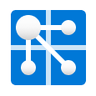


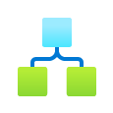



Azure Services
Integration
Event Hubs
Service Bus
Web PubSub
Notification Hub
Event Grid
Logic Apps
API Management
Energy Data Manager
Health Data Services
Notes:
Analytics
Seamlessly integrate on-premises and cloud-based applications, data, and processes across your enterprise
Event Hubs – Receive telemetry from millions of devices
https://azure.microsoft.com/services/event-hubs
Service Bus – Connect across private and public cloud environments
https://azure.microsoft.com/en-us/products/service-bus/
Web PubSub – Easily build real-time messaging web applications using WebSockets and the publish-subscribe pattern
https://azure.microsoft.com/en-us/products/web-pubsub/
Notification Hub – Send push notifications to any platform from any back end
https://azure.microsoft.com/services/notification-hubs
Event Grid – Get reliable event delivery at massive scale
https://azure.microsoft.com/services/event-grid
Logic Apps – Automate the access and use of data across clouds without writing code
https://azure.microsoft.com/services/logic-apps
API Management – Publish APIs to developers, partners, and employees securely and at scale
https://azure.microsoft.com/services/api-management
Energy Data Manager – Fully managed enterprise-grade OSDU Data Platform
https://azure.microsoft.com/products/energy-data-services/
Health Data Services – Unify and manage health data and protected health information (PHI) in the cloud
https://azure.microsoft.com/products/health-data-services

Slide 64

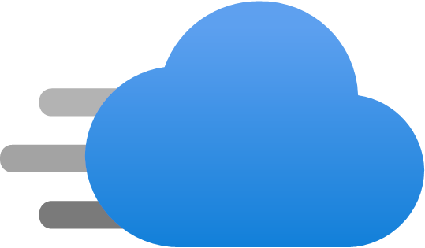
Azure Services
Media
Azure CDN
Media Service
Notes:
Analytics
Deliver high-quality video content anywhere, any time, and on any device
Azure CDN – Ensure secure, reliable content delivery with broad global reach
https://azure.microsoft.com/services/cdn
Media Services – Encode, store, and stream video and audio at scale
https://azure.microsoft.com/services/media-services

Slide 65


Azure Services
Communications
Azure Communications Gateway
Communication Services
Notes:
Communications
Azure Communications Gateway – Rapidly connect your fixed and mobile networks with Microsoft Teams
https://azure.microsoft.com/products/communications-gateway/
Communication Services – Build rich communication experiences with the same secure platform used by Microsoft Teams
https://azure.microsoft.com/services/communication-services

Slide 66




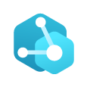


Azure Services
IoT
IoT Hub
IoT Central
IoT Edge
Azure Sphere
Digital Twins
Defender for IoT
Azure Maps
Notes:
IoT
Connect assets or environments, discover insights, and drive informed actions to transform your business
IoT Hub – Connect, monitor, and manage billions of IoT assets
https://azure.microsoft.com/en-us/products/iot-hub/
IoT Central – Experience the simplicity of SaaS for IoT, with no cloud expertise required
https://azure.microsoft.com/en-us/products/iot-central/
IoT Edge – Extend cloud intelligence and analytics to edge devices
https://azure.microsoft.com/en-us/products/iot-edge/
Azure Sphere – Securely connect MCU-powered devices from the silicon to the cloud
https://azure.microsoft.com/en-us/products/azure-sphere/
Digital Twins – Build next-generation IoT spatial intelligence solutions
https://azure.microsoft.com/services/digital-twins
Defender for IoT – Unified threat protection for all your IoT/OT devices
https://azure.microsoft.com/en-us/products/iot-defender/
Azure Maps – Simple and secure location APIs provide geospatial context to data
https://azure.microsoft.com/en-us/products/azure-maps/

Slide 67
















Azure Services
AI and Machine Learning
Cognitive Services
Machine Learning
OpenAI Service
Cognitive Search
AI Vision
AI Speech
AI Language
AI Translator
AI Document Intelligence
AI Bot Service
AI Video Indexer
AI Anomaly Detector
AI Content Safety
AI Personalizer
AI Metrics Advisor
AI Immersive Reader
Notes:
AI and Machine Learning
Create the next generation of applications using artificial intelligence capabilities for any developer and any scenario
Machine Learning – Bring AI to everyone with an end-to-end scalable, trusted platform with experimentation and model management
https://azure.microsoft.com/en-us/products/machine-learning/
Cognitive Services – Add smart API capabilities to enable contextual interactions includes search, vision, speech, language, translator, documents, bots, audio and video, decision, metrics advisor, and immersive reader
https://azure.microsoft.com/en-us/products/ai-services
Cognitive Search – Bring AI-powered cloud search to your mobile and web apps
https://go.microsoft.com/fwlink/?linkid=2246824
AI Vision
Azure AI Vision – Identify and analyze content within images and videos
https://go.microsoft.com/fwlink/?linkid=2247107
Azure AI Custom Vision – Customize image recognition to fit your business needs
https://go.microsoft.com/fwlink/?linkid=2247210
AI Speech
Speech to text – Transcribe audible speech into readable, searchable text
https://go.microsoft.com/fwlink/?linkid=2247111
Text to speech – Convert text to lifelike speech for more natural interfaces
https://go.microsoft.com/fwlink/?linkid=2247211
Speech translation – Integrate real-time speech translation into your apps
https://go.microsoft.com/fwlink/?linkid=2247007
Speaker recognition – Identify and verify the people speaking based on audio
AI Language – Understand conversations and understand text
Entity recognition – Identify commonly used and domain-specific terms, including PII extraction
https://go.microsoft.com/fwlink/?linkid=2246728
Sentiment analysis – Automatically detect sentiments and opinions from social media, customer reviews, and more
https://go.microsoft.com/fwlink/?linkid=2246918
Conversational language understanding – Enable your apps to interact with users through natural language
https://go.microsoft.com/fwlink/?linkid=2246729
Summarization – Generate summaries of documents and conversation transcripts
https://go.microsoft.com/fwlink/?linkid=2246728
Text analytics for health – Process unstructured medical data to improve patient care
https://go.microsoft.com/fwlink/?linkid=2246728
Question answering – Use AI to distill information into easy-to-navigate questions and answers.
https://go.microsoft.com/fwlink/?linkid=2246919
AI Translator – Translate content such as webpages, documents, conversations, and reviews across more than 125 languages and dialects
Text translation – Translate source text into multiple target languages in real time
https://go.microsoft.com/fwlink/?linkid=2246822
Document translation – Translate complex documents while preserving the structures and formats from the original documents
https://go.microsoft.com/fwlink/?linkid=2246915
Custom translator – Build customized models to translate domain-specific content and terminology in your style
https://go.microsoft.com/fwlink/?linkid=2246916
AI Document Intelligence – Turn documents into usable data at a faction of the time and cost
https://go.microsoft.com/fwlink/?linkid=2246731
AI Bot Service – Create bots and connects them across channels
https://go.microsoft.com/fwlink/?linkid=2246825
AI Video Indexer – Analyze audio and video files
https://go.microsoft.com/fwlink/?linkid=2246920
AI Decision – Mark smarter decisions faster
AI Anomaly Detector – Identify potential problems early on
https://go.microsoft.com/fwlink/?linkid=2247008
AI Content Safety – Detected potentially offensive or unwanted content
https://go.microsoft.com/fwlink/?linkid=2247009
AI Personalizer – Create rich, personalized experiences for every user.
https://go.microsoft.com/fwlink/?linkid=2247216
AI Metrics Advisor – Proactively monitor metrics and diagnose issues
https://go.microsoft.com/fwlink/?linkid=2247010
Immersive Reader – Embed text reading and comprehension capabilities
https://go.microsoft.com/fwlink/?linkid=2246733
OpenAI Service – Apply advanced coding and language models to a variety of use cases
https://azure.microsoft.com/en-us/products/cognitive-services/openai-service/

Slide 68




Azure Services
AI and Machine Learning
Machine Learning
Cognitive Services
OpenAI Services
Applied AI Services
Open Datasets
Project Bonsai
Microsoft Genomics
Notes:
AI and Machine Learning (cont)
Create the next generation of applications using artificial intelligence capabilities for any developer and any scenario
Applied AI Services – Bring AI to everyone with an end-to-end scalable, trusted platform with experimentation and model management
https://azure.microsoft.com/en-us/products/machine-learning/
Open Datasets – Cloud platform to host and share curated open datasets to accelerate development of machine learning models
https://azure.microsoft.com/en-us/products/open-datasets/
Project Bonsai – Create intelligent industrial control systems using simulations
https://learn.microsoft.com/en-us/bonsai/
Microsoft Genomics – Power genome sequencing and research insights
https://azure.microsoft.com/en-us/products/genomics/

Slide 69
Azure Services
Mixed Reality
Remote Rending
Object Anchors
Spatial Anchors
Time Series Insights
Notes:
Mixed Reality
Blend your physical and digital worlds to create immersive, collaborative experiences
Remote Rending – Render high-quality, interactive 3D content, and stream it to your devices in real time
https://azure.microsoft.com/services/remote-rendering
Object Anchors – Automatically align and anchor 3D content to objects in the physical world
https://azure.microsoft.com/services/object-anchors
Spatial Anchors – Create multi-user, spatially aware mixed reality experiences
https://azure.microsoft.com/services/spatial-anchors
Time Series Insights – Explore and analyze time-series data from IoT devices
https://azure.microsoft.com/en-us/products/time-series-insights/

Slide 70
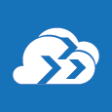

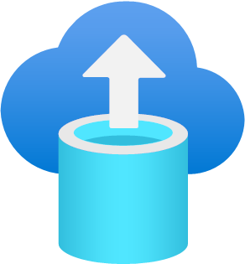


Azure Services
Migration
Azure Migrate
Data Box
DB Migration Service
Resource Mover
Site Recovery
Notes:
Migration
Simplify and accelerate your migration to the cloud with guidance, tools, and resources
Azure Migrate – Easily discover, assess, right-size, and migrate your on-premises VMs to Azure
https://azure.microsoft.com/services/azure-migrate
Data Box – Appliances and solutions for data transfer to Azure and edge compute
https://azure.microsoft.com/services/databox
DB Migration Service – Simplify on-premises database migration to the cloud
https://azure.microsoft.com/services/database-migration
Resource Mover – Simplify how you can move multiple resources between Azure regions
https://azure.microsoft.com/products/resource-mover/
Site Recovery – Keep your business running with built-in disaster recovery service
https://azure.microsoft.com/services/site-recovery

Slide 71
Example Architectures
Azure: Unleashing the Power of Cloud Computing

Slide 72

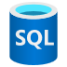


Simple SaaS Application
Control Plane
Identity Framework
Email Notification Provider
Tenant Data Storage
Identity Provider (B2C)
Onboarding and admin app
Tenant Data
API
Permission Data API
Permission Data Storage
End-User SaaS Application
SaaS App
SaaS App API
SaaS App Data Storage
Notes:
https://learn.microsoft.com/en-us/azure/architecture/example-scenario/apps/saas-starter-web-app

Slide 73
Serverless Web Application
Notes:
https://learn.microsoft.com/en-us/azure/architecture/web-apps/serverless/architectures/web-app

Slide 74
E-Commerce Website
Notes:
https://learn.microsoft.com/en-us/azure/architecture/web-apps/idea/ecommerce-website-running-in-secured-ase
Dataflow
Customer accesses the public website in browser.
Browser pulls static resources and product images from Azure Content Delivery Network.
Content Delivery Network pulls product images from blob storage.
Customer searches for products.
Public website pulls product catalog from product database.
Page output is cached in the Azure Cache for Redis.
Customer creates new orders.
Public website invokes orders web service.
Orders web service saves/loads orders from Azure SQL Database.
Employee accesses the admin website in browser.
Employee authenticates against Azure Active Directory (Azure AD).
Employee searches orders.
Admin website invokes orders web service.
Components
App Service: Quickly create powerful cloud apps for web and mobile
Web Apps: An App Service Web App runs in a single region, accessible to web and mobile browsers
Azure SQL Database: Managed, intelligent SQL in the cloud
API Apps: Publish APIs to external, partner, and employee developers securely and at scale.
Application Insights: Detect, triage, and diagnose issues in your web apps and services
Application Gateway: Build secure, scalable, and highly available web front ends in Azure
Azure Cache for Redis: Power applications with high-throughput, low-latency data access
Content Delivery Network: Ensure secure, reliable content delivery with broad global reach
Azure Active Directory: Synchronize on-premises directories and enable single sign-on
Blob Storage: Azure Blob storage is a Massively scalable object storage for any type of unstructured data-images, videos, audio, documents, and more-easily and cost-effectively.

Slide 75
Mission-Critical Baseline Architecture
Notes:
https://learn.microsoft.com/en-us/azure/architecture/reference-architectures/containers/aks-mission-critical/mission-critical-intro

Slide 76
Sports Analytics
Notes:
https://learn.microsoft.com/en-us/azure/architecture/example-scenario/analytics/sports-analytics-architecture-azure
Dataflow
Data is ingested from source systems by using one of the following methods:
Azure Data Factory ingests raw data from several data sources and stores it in Azure Data Lake Storage for downstream processing.
Some raw data sources might be large and might not need the raw data to be stored in Data Lake Storage initially, like the spatial on-court/on-field data. In these cases, you can use Azure Databricks to ingest source data and immediately transform data so that it's cleansed, normalized, and saved to Data Lake Storage in an easy-to-digest format.
Data that's generated by sensors in real-time is ingested as messages by Azure Event Hubs.
Azure Databricks transforms raw data so that it's cleansed of any errors and normalized. With the cloudFiles feature of Azure Databricks Auto Loader, raw files are automatically processed as they land in Data Lake Storage. The transformed data moves back into Data Lake Storage for further curating.
Azure Databricks applies business logic to the transformed data. Stream data is also combined with the transformed data during this process.
Azure Databricks processes stream data from Azure Event Hubs and combines it with static data.
The final processed data is written to Data Lake Storage in Delta format.
Transformed data that's used in the visualization layer, like Power BI, is written to an Azure SQL Database. This database becomes the data source for any reporting needs.
Curated data is visualized and manipulated through Power BI, Power Apps, or a custom web application that's hosted by an Azure App Service.
Azure Machine Learning builds and trains machine learning models by using data imported into Azure Machine Learning Datasets and external sources. The datasets and sources are directly linked to the Azure Machine Learning Workspace. You can control access and authentication for data and the Machine Learning workspace with Azure Active Directory (Azure AD) and Azure Key Vault. Models can also be retrained as necessary in Machine Learning.
As an alternative to storing model results in Data Lake Storage or SQL Database, you can deploy Machine Learning models to containers using Azure Kubernetes Services (AKS) as a web service and called via a REST API endpoint. The web service deploys by using an Azure App Service, and then you can send data to the REST API endpoint and receive the prediction returned by the model within the web application.
Throughout the process:
Azure Monitor collects information on events and performance.
Key Vault secures passwords, connection strings, and secrets.
Azure DevOps manages code repositories and deployment pipelines.

Slide 77
Serverless Apps using Cosmos DB
Notes:
https://learn.microsoft.com/en-us/azure/architecture/solution-ideas/articles/serverless-apps-using-cosmos-db
Dataflow
A customer places an order in an e-commerce website.
The order triggers an instance of Functions. The function processes the customer's checkout and stores information about the order in Azure Cosmos DB.
The database insert operation triggers an Azure Cosmos DB change feed event.
Systems that subscribe to change feed events are notified.
The change feed notifications trigger Functions:
A function applies taxes to the order.
A function processes payment for the order.
A function fulfills the order.

Slide 78
Summary
Understanding Cloud Computing
History
Importance of Cloud Computing
Scalability and Flexibility
Cost Efficiency
Global Accessibility
Innovation Acceleration
Faster Time-to-Market
Disaster Recovery and Business Continuity
Security and Compliance
Environmental Impact
Collaboration and Mobility
Focus on Core Competencies
Support for Modern Workloads

Slide 79
Summary
Understanding Cloud Computing
History
Importance of Cloud Computing
Scalability and Flexibility
Cost Efficiency
Global Accessibility
Innovation Acceleration
Faster Time-to-Market
Disaster Recovery and Business Continuity
Security and Compliance
Environmental Impact
Collaboration and Mobility
Focus on Core Competencies
Support for Modern Workloads

Slide 80
Summary
Understanding Cloud Computing
History
Importance of Cloud Computing
Cloud Service Models
Infrastructure as a Service (IaaS)
Platform as a Service (PaaS)
Serverless / Function as a Service (FaaS)
Software as a Service (SaaS)

Slide 81
Summary
Understanding Cloud Computing
History
Importance of Cloud Computing
Cloud Service Models
Infrastructure as a Service (IaaS)
Platform as a Service (PaaS)
Serverless / Function as a Service (FaaS)
Software as a Service (SaaS)

Slide 82
Summary
Understanding Cloud Computing
History
Importance of Cloud Computing
Cloud Service Models
Cloud Deployment Models
Public Cloud
Private Cloud
Hybrid Cloud

Slide 83
Summary
Understanding Cloud Computing
History
Importance of Cloud Computing
Cloud Service Models
Cloud Deployment Models
Public Cloud
Private Cloud
Hybrid Cloud

Slide 84

Summary
Understanding Cloud Computing
History
Importance of Cloud Computing
Cloud Service Models
Cloud Deployment Models
Cloud Marketspace

Slide 85
Summary
Understanding Cloud Computing
History
Importance of Cloud Computing
Cloud Service Models
Cloud Deployment Models
Cloud Marketspace

Slide 86
Summary
Compute
Networking
Identity and Security
Storage
Databases
Analytics
Development
Integration
Media
Communications
IoT
AI and Machine Learning
Mixed Reality
Migration
Understanding Cloud Computing
History
Importance of Cloud Computing
Cloud Service Models
Cloud Deployment Models
Cloud Marketspace
Microsoft Azure
History
Azure Regions
Services
Notes:
History – February 2010
Azure Regions – 48 active regions; 17 regions coming; 65 total
Azure Services

Slide 87
Summary
Compute
Networking
Identity and Security
Storage
Databases
Analytics
Development
Integration
Media
Communications
IoT
AI and Machine Learning
Mixed Reality
Migration
Understanding Cloud Computing
History
Importance of Cloud Computing
Cloud Service Models
Cloud Deployment Models
Cloud Marketspace
Microsoft Azure
History
Azure Regions
Services
Notes:
History – February 2010
Azure Regions – 48 active regions; 17 regions coming; 65 total
Azure Services

Slide 88
Summary
Understanding Cloud Computing
History
Importance of Cloud Computing
Cloud Service Models
Cloud Deployment Models
Cloud Marketspace
Microsoft Azure
History
Azure Regions
Services
Example Architectures
Simple SaaS Application
Serverless Web Application
E-Commerce Website
Mission-Critical Baseline Architecture
Sports Analytics
Serverless Apps using Cosmos Db
Notes:
History – February 2010
Azure Regions – 48 active regions; 17 regions coming; 65 total
Azure Services

Slide 89

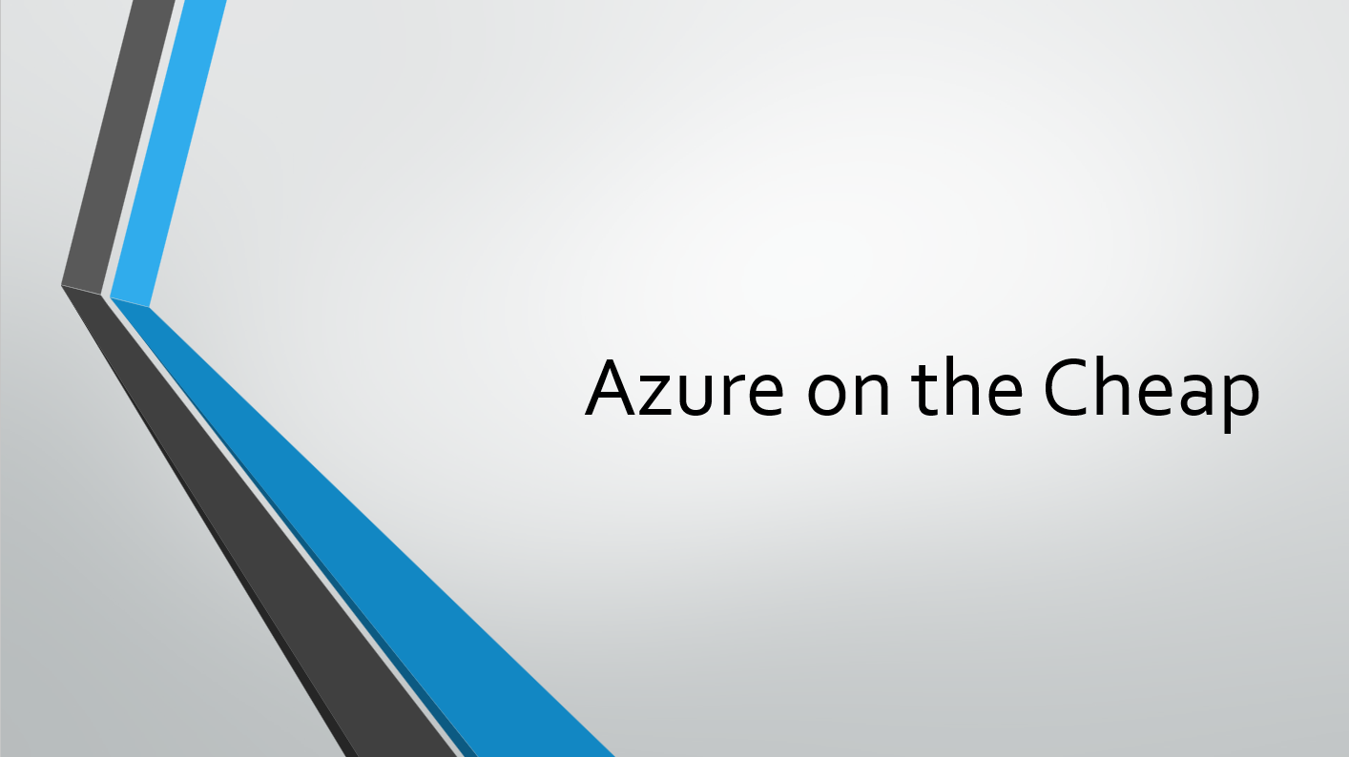
What Next?
Free Azure Account
https://azure.Microsoft.com/free
Download Slides
Attend Next Month’s Meetup

Slide 90
Thank You
chadgreen@chadgreen.com
TaleLearnCode
ChadGreen.com
ChadGreen & TaleLearnCode
ChadwickEGreen

